Slide 1
FINAL DEFENSE “Text-to-Image Generator”
Neha Shrestha (24287 / 7th Semester / 2076)
Norden Ghising Tamang (24290 / 7th Semester / 2076)

Slide 2
CHAPTER - 1: INTRODUCTION

Slide 3
1.1. INTRODUCTION
Generative AI is subfield of AI
Generates new data such as images, texts, videos, audios, etc.
Generative AI learns probability distribution and use it for inference
Diffusion Models a popular approach
Model is based on Latent Diffusion

Slide 4
1.2. PROBLEM STATEMENT
Data scarcity can be solved through Generative AI.
Text-to-image model enhances understanding and communication visually.
Idea can be represented quickly through the model without technical expertise.

Slide 5
1.3. OBJECTIVE
To transform textual descriptions into visually appealing images.
To ensure the generated images are coherent and contextually accurate.
To provide a user-friendly interface for users to input text and retrieve generated images.

Slide 6
1.4. SCOPE
Expresses textual prompts to visual images.
Serves as an educational tool, aiding in the creation of visual aids for educational materials.
Preferred text prompts can be given by users to derive images.
Facilitates easy user interaction.

Slide 7
1.4. LIMITATIONS
Only a limited class of images (2-5).
Heavily dependent on the training data.
Highly complex and abstract textual prompts.
Without a powerful GPU system, processing is slow and scalability is limited.

Slide 8
CHAPTER - 2: LITERATURE REVIEW

Slide 9
2.2. LITERATURE REVIEW
Denoising Diffusion Probabilistic Model
Improved Denoising Diffusion Probabilistic Model
Taming Transformers for High-Resolution Image Synthesis
High-Resolution Image Synthesis with Latent Diffusion Models
Auto-Encoding Variational Bayes
U-Net: Convolutional Networks for Biomedical Image Segmentation

Slide 10
CHAPTER - 3:
SYSTEM ANALYSIS

Slide 11
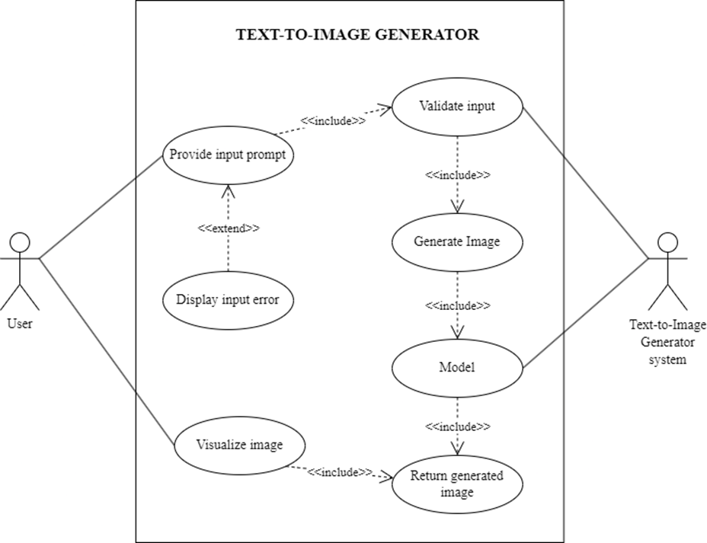
3.1 System Analysis
3.1.1 Requirement Analysis:
3.1.1.i. Functional Requirement
Use Case Diagram
3.1.1.ii. Non-functional Requirement
Performance
Reliability
Usability

Slide 12
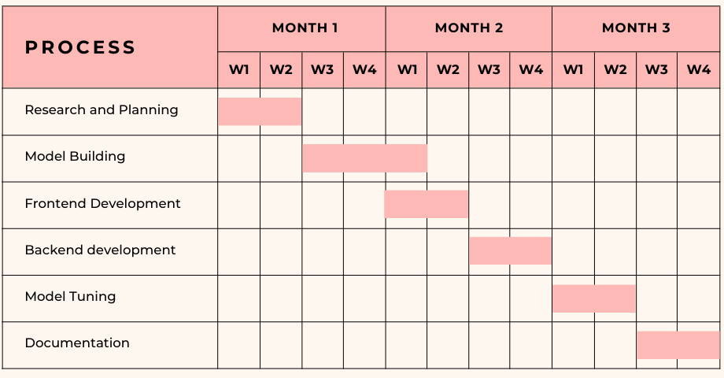
3.1 System Analysis
3.1.2 Feasibility Analysis:
3.1.2.i. Technical Feasibility
3.1.2.ii. Schedule Feasibility
3.1.3.iii. Economic Feasibility

Slide 13
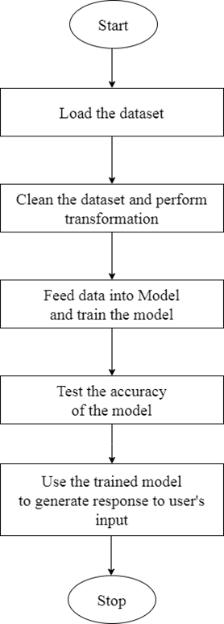
3.1 System Analysis
3.1.3 Analysis:
3.1.3.i. Flow Diagram

Slide 14
CHAPTER - 4:
SYSTEM DESIGN

Slide 15
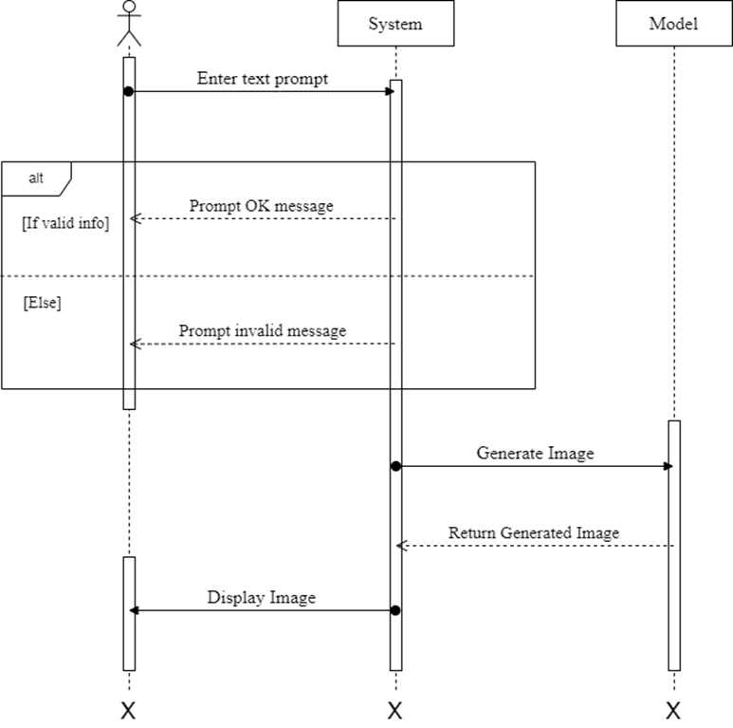
4.1 Design
4.1.1 Sequence Diagram

Slide 16
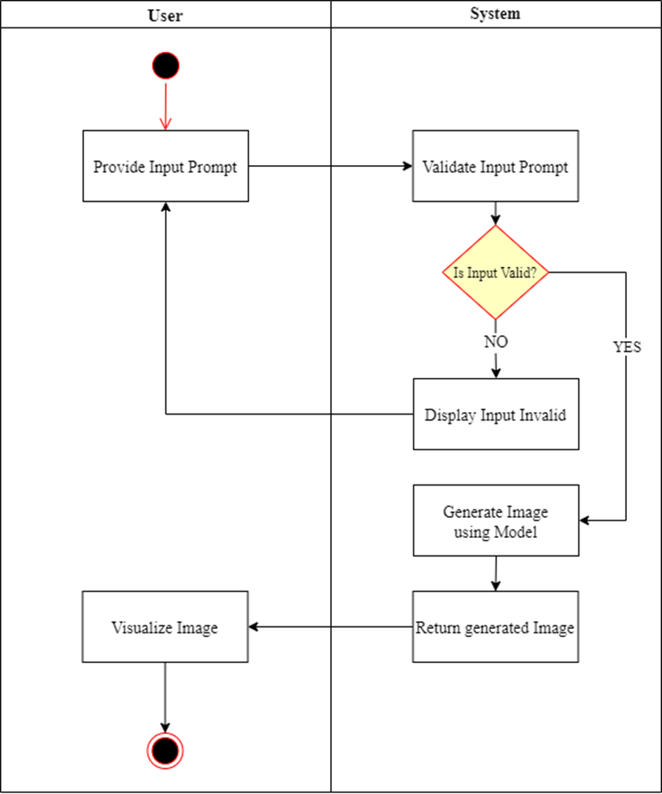
4.1 Design
4.1.2. Activity Diagram

Slide 17
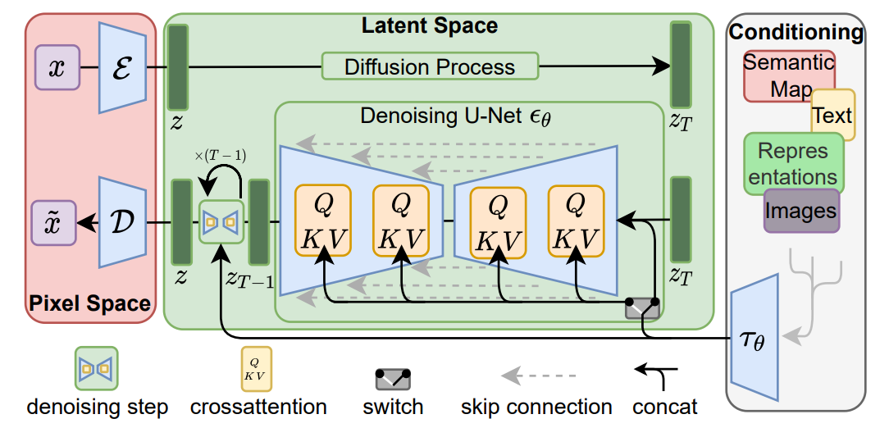
4.2. Algorithm Details
Autoencoder
Gaussian Noise and Forward Diffusion
Denoising U-Net and Reverse Diffusion
Fig: Architecture of the Model

Slide 18
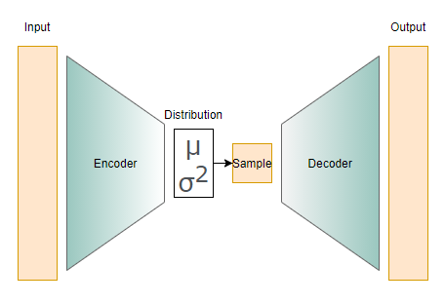
Autoencoder

Slide 19
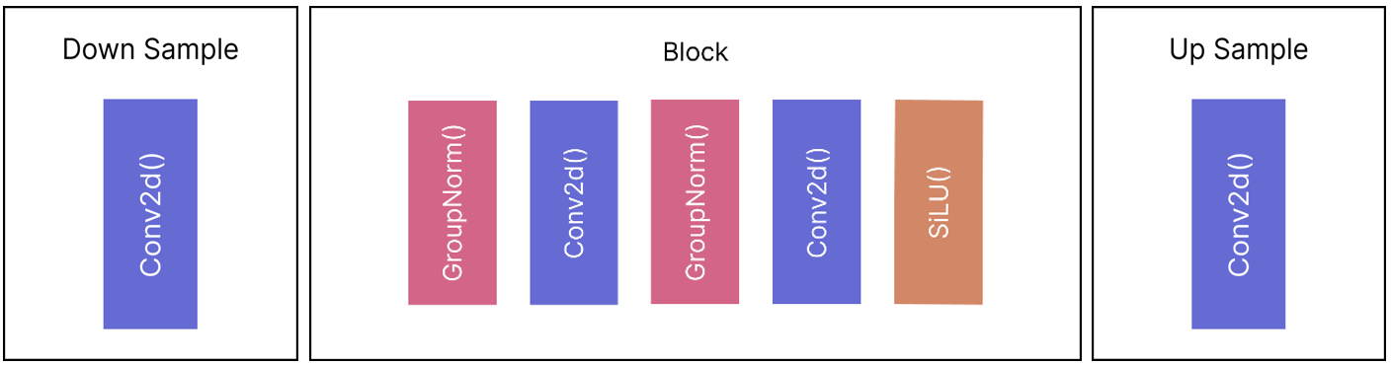
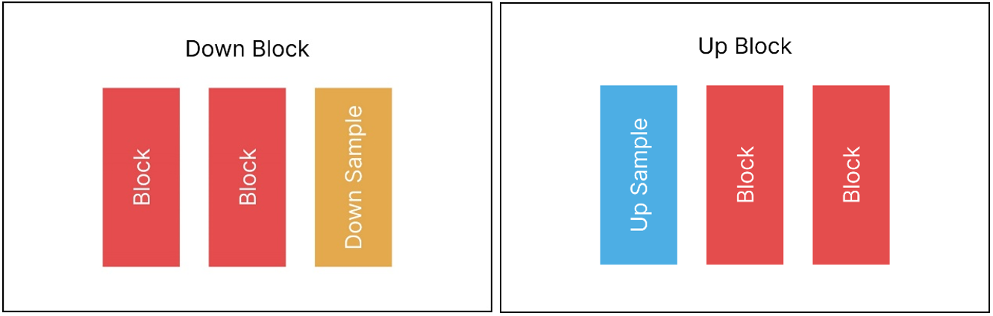

Slide 20
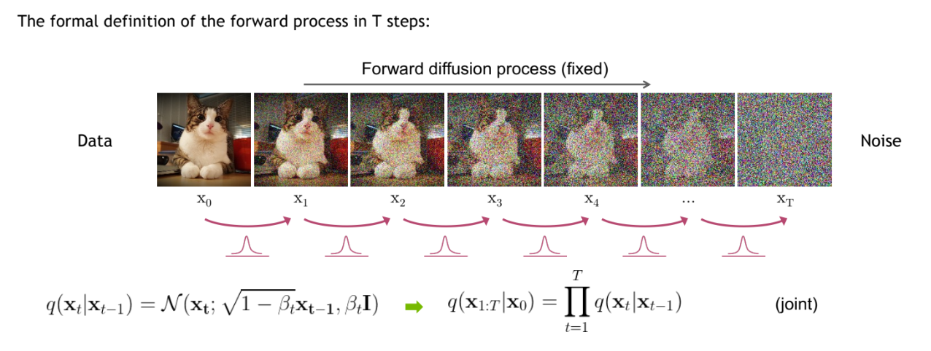
Forward Diffusion Process

Slide 21
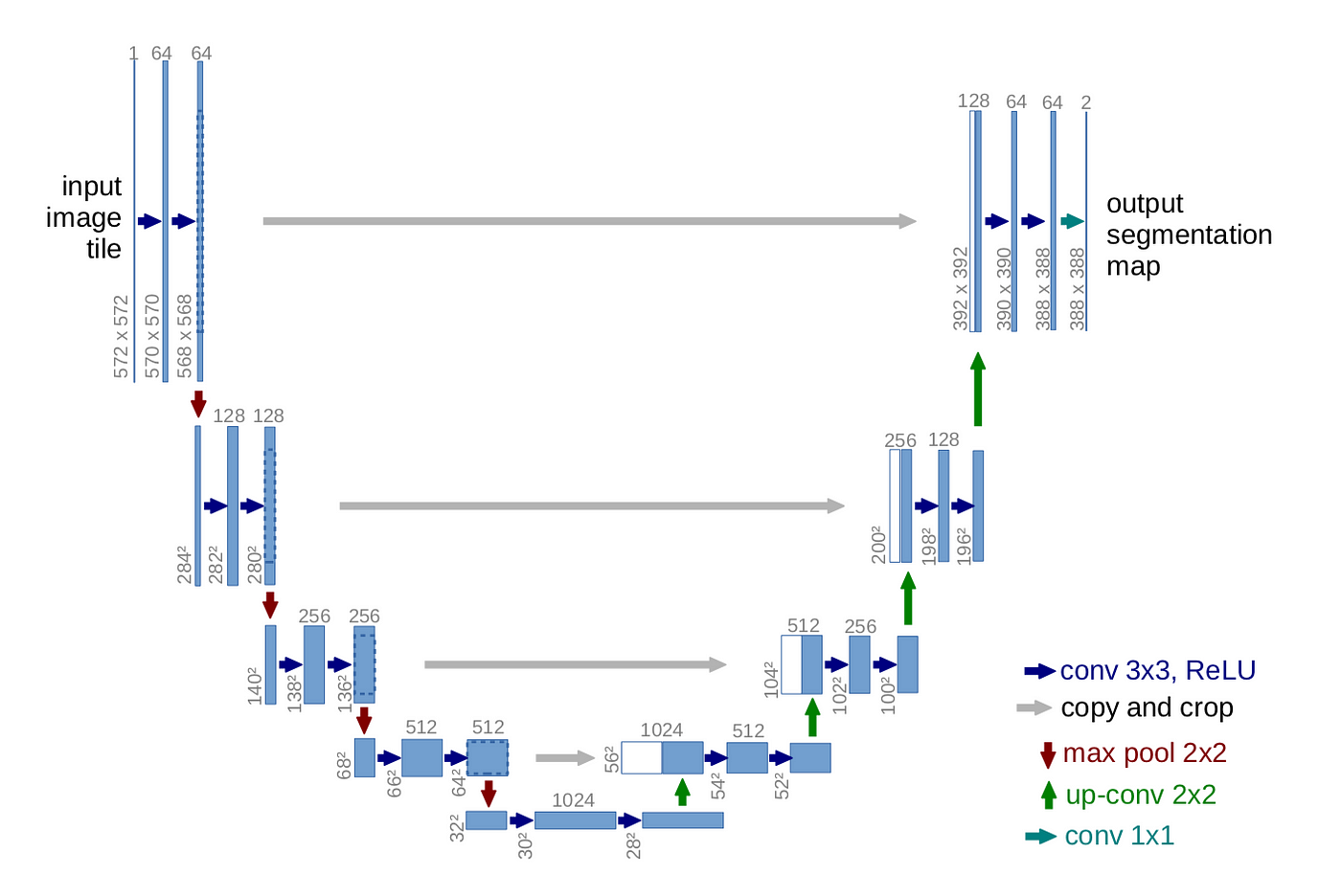
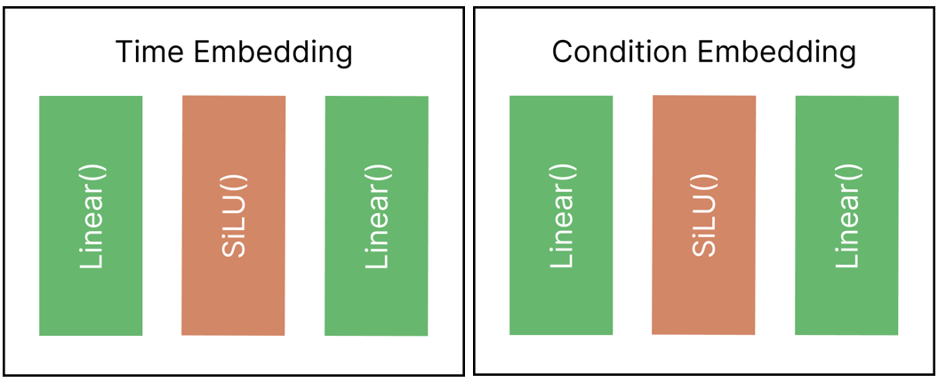
UNet

Slide 22
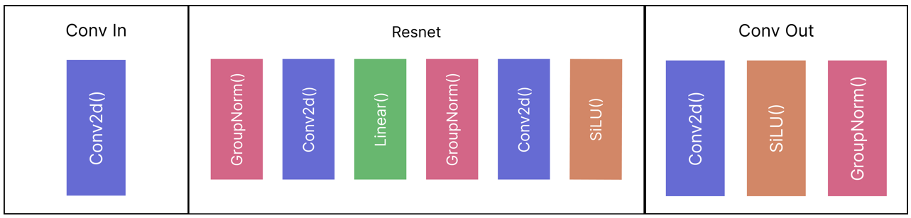
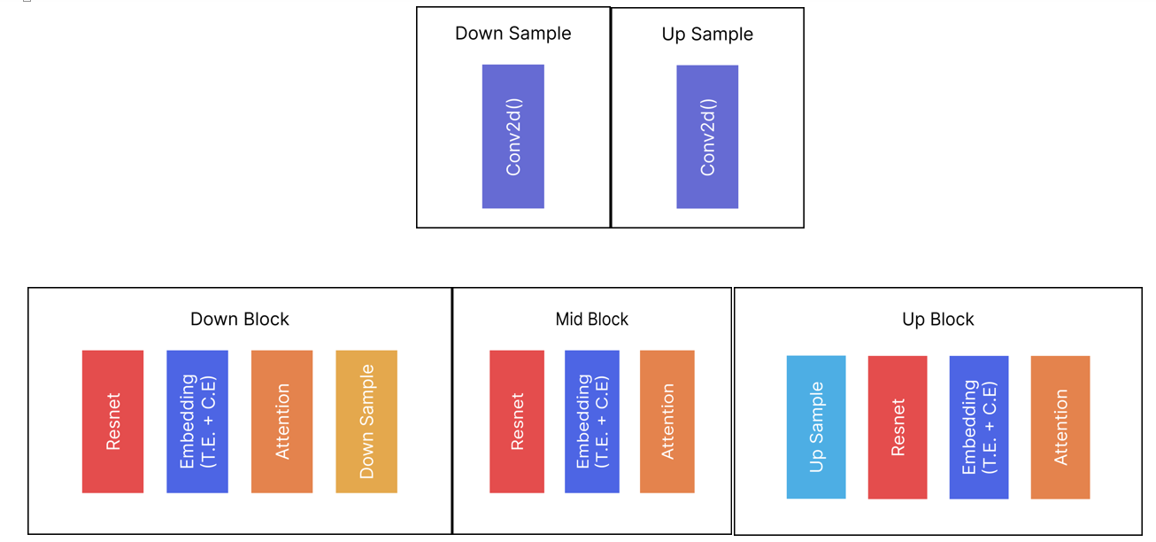

Slide 23
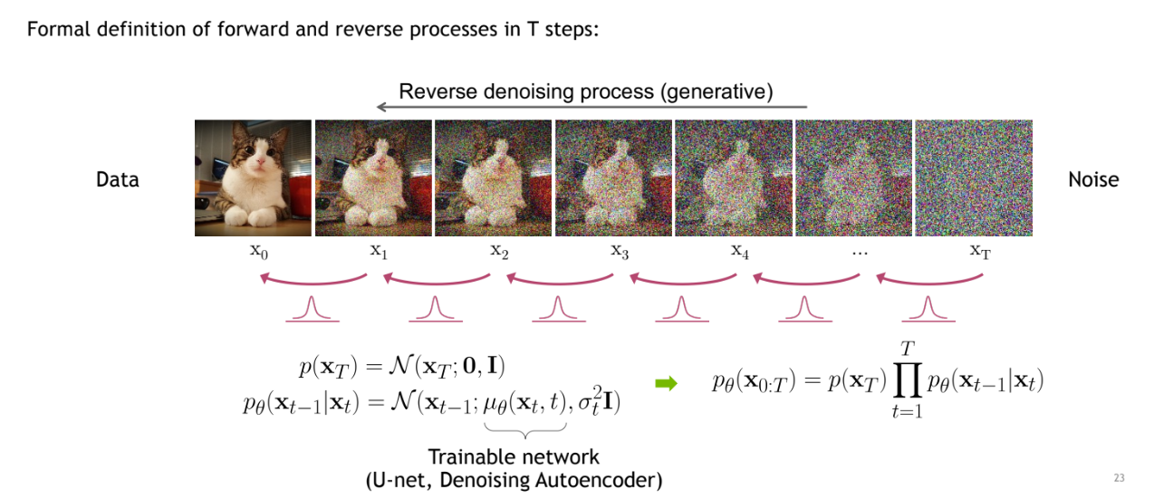
Reverse Diffusion Process

Slide 24
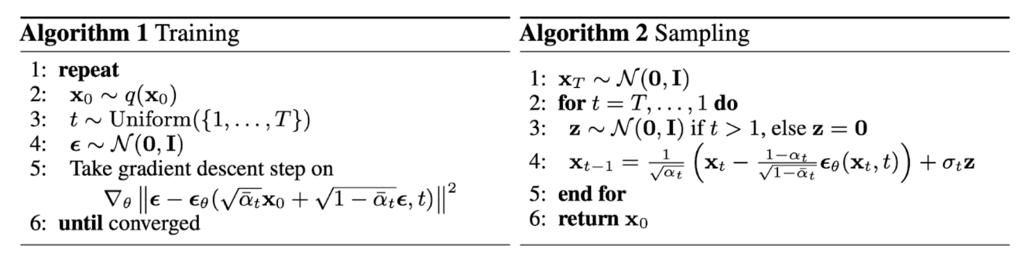

Slide 25
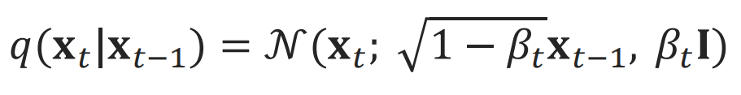
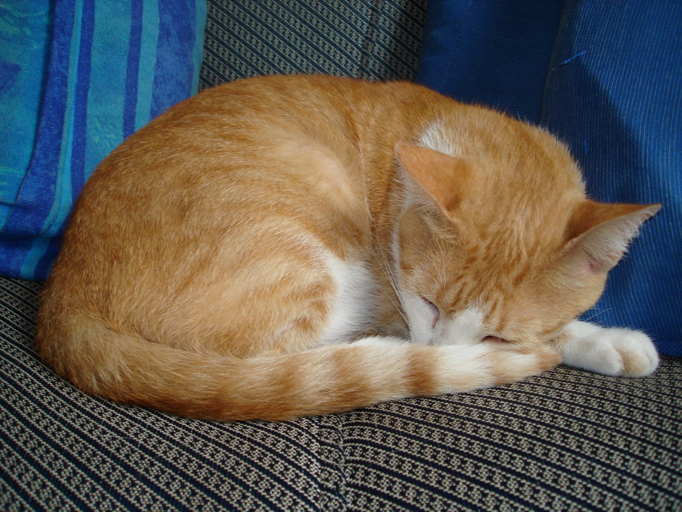
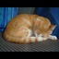
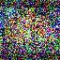
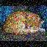
32 X 32
8 times less
Cat
256 X 256
Mean
Variance
Cat = 0
Dog = 1

Slide 26
CHAPTER - 5:
IMPLEMENTATION

Slide 27
5.1 IMPLEMENTATION OF MODULES
1. app.py
Launches Gradio interface for user interaction.
Provides mechanism to train own LDM model by equipping hyper parameters.
Dependencies on functionalities provided by 'ldm.py'.

Slide 28
5.1 IMPLEMENTATION OF MODULES
2. dataset.py
CustomDataset
Extends PyTorch’s dataset class.
Handles folder image dataset, providing load and preprocess methods
NumpyDS
Specialized class for latent images represented as NumPy files.
Extends ‘CustomDataset’ for consistent handling.

Slide 29
5.1 IMPLEMENTATION OF MODULES
3. dataloader.py
Contains latent_dataloader() and loads the dataset using ‘NumpyDS’
4. data_preprocessing.py
data_to_latents()
Takes VAE model, data folder, latent folder, and preprocessing parameters.
Uses ‘CustomDataset’ and PyTorch’s DataLoader for preprocessing.
Encodes image data with VAE, saves latents in NumPy format.
data_preprocessing()
Calls ‘data-to-latents()’ method using VAE and creates latent images and puts it on ‘latent_folder’ directory.

Slide 30
5.1 IMPLEMENTATION OF MODULES
5. ldm.py
Initializes and manages instances of UNet and VAE and loads their weights
Instantiates DDPM Sampler
Contains ‘generate_image()’ function that handles all tasks from noise creation to return of generated image
6. ldm_components.py
Contains all the models and components used to create LDM such as VAE, DDPM and U-Net.

Slide 31
5.1 IMPLEMENTATION OF MODULES
7. inference.py
Defines an `inference` function that generates an image using a DDPM and a U-Net model.
Creates a tensor of random noise, denoises the image using the U-Net model and DDPM scheduler, and saves intermediate and final images if specified.
Returns the final denoised image and a plot of saved images.
8. trainer.py
Defines two functions, `train` and `cancel`
`train` function trains a U-Net model using a denoising diffusion probabilistic model (DDPM) and a Variational Autoencoder (VAE) model
`cancel` function sets a global flag to stop the training process.

Slide 32
5.1 IMPLEMENTATION OF MODULES
9. utils.py
Various functions like ‘get_class_tensor’, ‘get_class_name’, ‘latents_to_pil’, ‘plot_images_from_folder’, ‘save_images’ and ‘plot_results’ are used for data processing, visualization, and evaluation
10. ldm.ipynb
Jupyter notebook for training purposes.
Tasks:
Instantiates UNet, VAE, and DDPMscheduler.
Utilizes functionalities from 'dataset.py' and 'data_preprocessing.py'.
Executes PyTorch training loop for 1000 epochs, saving the model.
Plots training loss.
Conducts inference, showcasing the generative capabilities of the model.

Slide 33
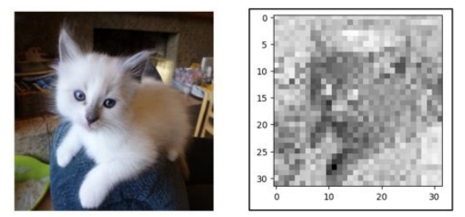
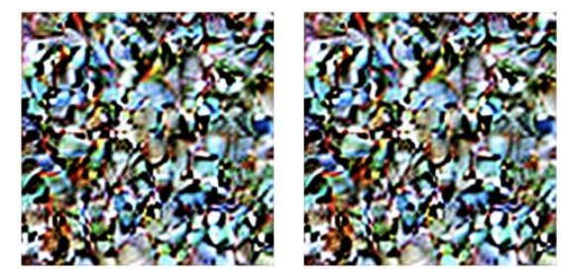
5.2 TESTING
5.2.1 Unit Testing
VAE Test: b. U-Net Test:

Slide 34
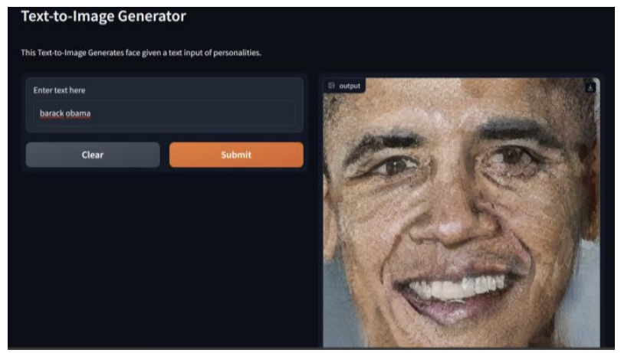
5.2.2 System Testing
5.2.3 User Testing

Slide 35
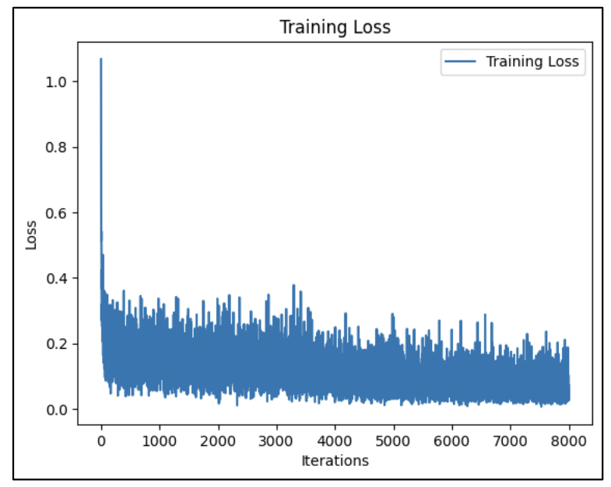
5.3 RESULT ANALYSIS
5.3.1 Loss Analysis:
Used MSE loss as our loss function.
Converged to a loss of 0.043
i.e. 4.3% after 1000 epochs.

Slide 36
CHAPTER - 6:
CONCLUSION AND FUTURE RECOMMENDATIONS

Slide 37
6.1 CONCLUSION
Demonstrates advancements in generative modeling for synthesizing images from textual descriptions.
Integration of state-of-the-art techniques like diffusion model, UNet, and VAE powers Generative AI.
Utilization of PyTorch and Diffusers library ensures scalability, efficiency, and real-time processing capabilities.

Slide 38
6.2 RECOMMENDATIONS
Enhanced Attention Mechanisms
Integration of Transfer Learning
User Interface Improvements
Ethical Considerations
Scalability and Optimization

Slide 39
REFERENCES
[1] Robin Rombach, Andreas Blattmann, Dominik Lorenz, Patrick Esser, Bjorn Ommer, “High-Resolution Image Synthesis with Diffusion Models”, Arxiv, Apr. 13, 2022. [Online]. Available: https://arxiv.org/pdf/2112.10752.pdf
[2] Patrick Esser, Robin Rombach, Bjorn Ommer, “Taming Transformers for High-Resolution Image Synthesis” Arxiv, Dec. 16, 2020. [Online]. Available: https://arxiv.org/pdf/2006.11239.pdf
[3] Jonathan Ho, Ajay Jain and Pieter Abbeel, “Denoising Diffusion Probabilistic Models”, Arxiv, Dec. 16, 2020. [Online]. Available: https://arxiv.org/pdf/2006.11239.pdf
[4] Olaf Ronneberger, Philipp Fischer and Thomas Brox, “U-Net: Convolutional Networks for Biomedical Image Segmentation”, Arxiv, May. 18, 2015. [Online]. Available: https://arxiv.org/pdf/1505.04597.pdf
[5] Alex Nichol and Prafulla Dhariwal, “Improved Denoising Diffusion Probabilistic Models,” Feb. 2021. [Online]. Available: https://arxiv.org/pdf/2102.09672.pdf
[6] J. Sohl-Dickstein, E. Weiss, N. Maheswaranathan, S. Ganguli, and S. Edu, “Deep Unsupervised Learning using Nonequilibrium Thermodynamics,” Nov. 2015. Available: https://arxiv.org/pdf/1503.03585.pdf
[7] D. P. Kingma and M. Welling, “Auto-Encoding Variational Bayes,” arXiv.org, Dec. 20, 2013. Available: https://arxiv.org/abs/1312.6114

